Slide 1


SOMERSET PURPOSE
S - Set high expectations
O - Objective
M - Meaningful curriculum
E - Effective
R - Resourceful and responsible life long learners
S - Scholars who achieve proficiency and beyond
E - Evaluate continuously and use data to drive curriculum
T - Teachers who are highly qualified
Somerset Academy, Inc. promotes a transformational culture that maximizes student achievement and the development of accountable, global learners in a safe and enriching environment that fosters high-quality education.

Slide 2


Slide 3


Slide 4

DO NOT. . .
“Hang out” in the stairwells or on the second floor during lunch.
Chew gum. DO NOT BRING GUM!
Go on the basketball court with a skateboard!
Use the elevator without approval from the office.
Leave campus if you are a Middle Schooler, Freshman or Sophomore (Except for DE students)
Allow an underclassmen in your vehicle without prior permission, or you will lose all privileges for the remainder of the school year.
Throw anything off the balcony.
Throw anything from the ground level to the 2nd floor.
Eat or carry food over the basketball court or turf field
Litter or leave garbage around at lunch
Hang out by the wavy wall side or behind the basketball court bleachers
Hang on or grab the basketball nets/rims
Playing “keep away” = a detention
Yoga pants/ leggings/ are not allowed. Not even during dress down days. Dress code violations earn detentions
You are not to go to the Deans’ office during class to argue a detention. You will be turned away.

Slide 5

BEHAVIORAL EXPECTATIONS
•Familiarize yourself with the Parent/Student Handbook and the policies within.
•Show respect and support for yourself, the teachers, and the school by complying with Somerset’s discipline policy, attendance policy, academic policies, and dress code/uniform policies.
•Comply with academic expectations by maintaining a GPA of 2.0 or higher, completing and turning in homework/assignments/projects; being prepared for class and requesting help when needed.
•Demonstrate integrity, honesty and appropriate behavior in all interpersonal relationships.

Slide 6

No Cell Phones
Off and away the entire day
1st Violation – Detention
Parent notification submit phone to main office
2nd Violation – Saturday Detention
Parent notification submit phone to administration
3rd Violation – Referral Suspension & Behavior Probation
Device must be picked up by a legal guardian

Slide 7
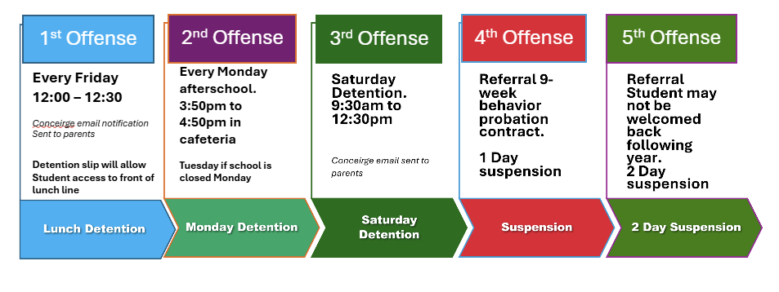
Discipline Matrix

Slide 8










Dress Code Violations (Do Not Wear)
Ripped or Frayed Jeans
Non - Somerset, Hoodies or Polos
Crocs, Slides & Foam Runners
Sweatpants, Joggers, Yoga pants, tights or Pajama pants

Slide 9
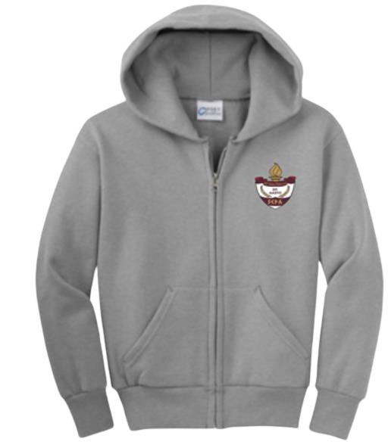

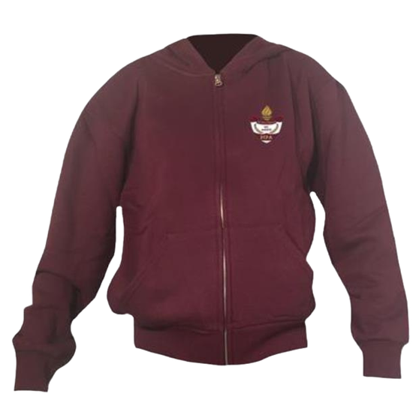
SCPA DRESS CODE VIOLATIONS
  A Somerset shirt must be worn underneath a zip up Hoodie or Jacket.
  Exceptions would include
    House Shirts
    Club Shirt Days
    School Athletic apparel for game days.
  Anyone not in compliance will be given a Dress Code Violation according to our Discipline Matrix.

Slide 10



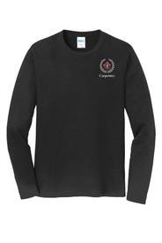
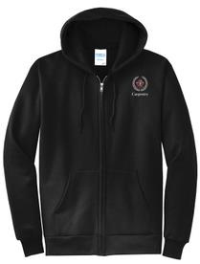

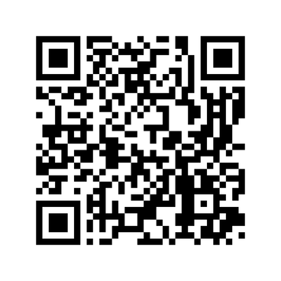

SCA Dress Code
For high school students:
Uniforms can be ordered through the website: www.somersetcareeracademy.org, under students>uniforms. High School students will wear black tops.

Slide 11
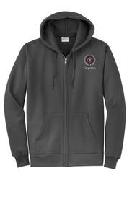
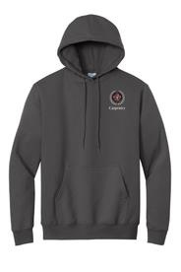
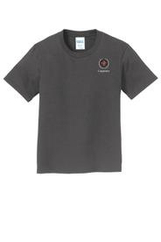
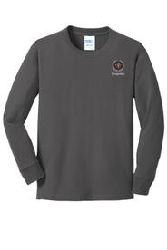
SCA Dress Code
For middle school students (grades 6-8):
Uniforms can be ordered through the website: www.somersetcareeracademy.org, under students>uniforms. Middle School students will wear charcoal colored tops.

Slide 12
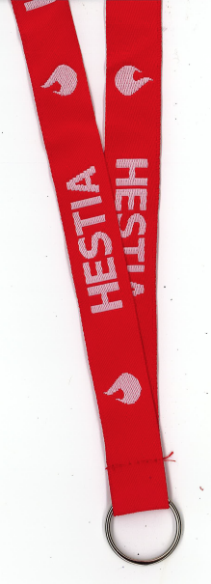
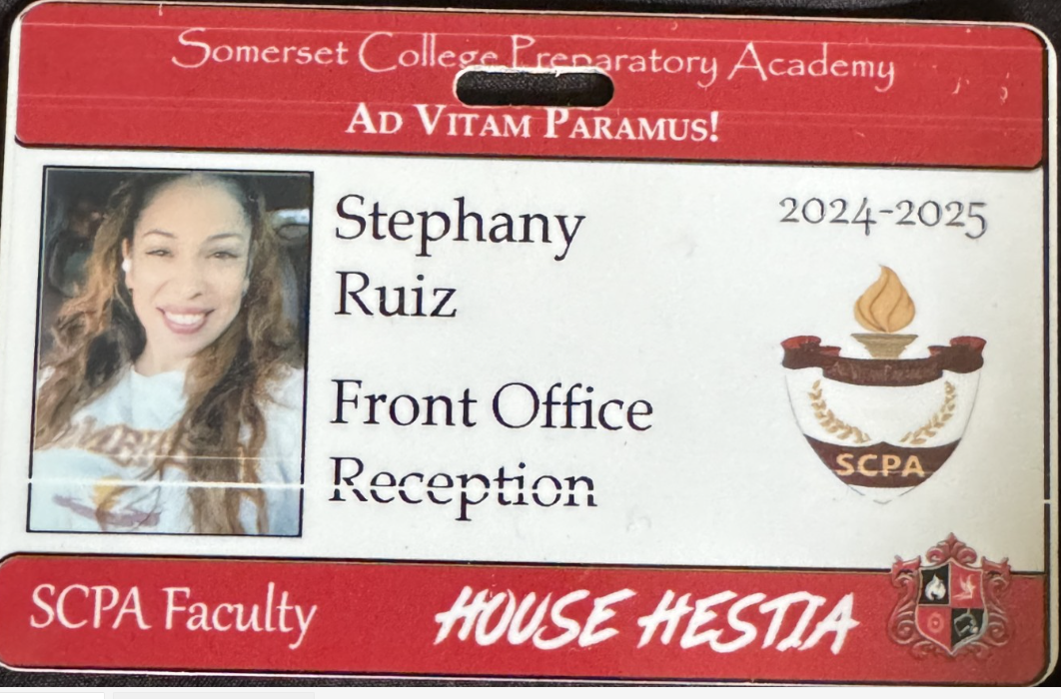
Lanyards and IDs are a Mandatory
Part of your uniform
Keep in your backpack
Needs to be worn everyday you’re at school
No Lanyard and ID will result in a dress code violation.
Purchase in Front Office
Lanyard $4
ID $4 (Cash Only)

Slide 13

Lanyard Policy!
-Do NOT WEAR ANOTHER STUDENT’S ID (It’s basically fraud and you’ll get a referral)
Rule:
Worn around neck ONLY
Consequence
pocket/bookbag = detention

Slide 14
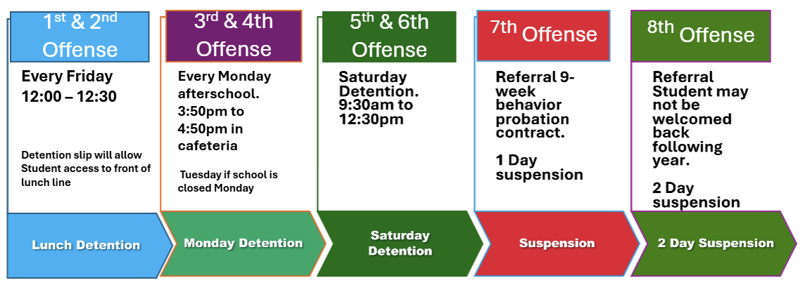
Discipline Matrix (Uniform Violation)

Slide 15
RESTROOM POLICY
•. 1st and Last 10 minutes
Designated Restrooms (A, B, C)
•. Period 4 (3:15)
•. Planners $5.00
•. Students must sign in & out of the classrooms

Slide 16
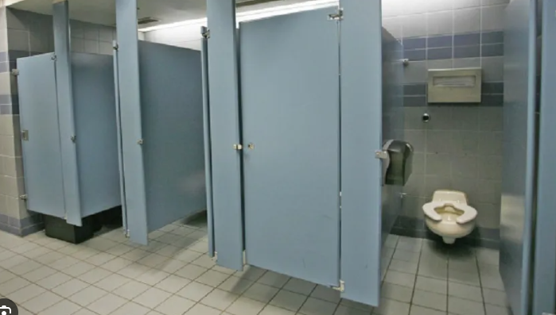
ONE (1) Student in a Stall at a time!
This includes the Large Stall!!
Consequences will be distributed.

Slide 17







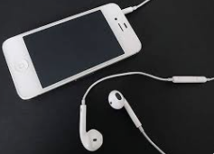
No Wireless Communication Devices
Off & Away for the entire day
No Devices
Smart Watches, Earphones, Tablets

Slide 18
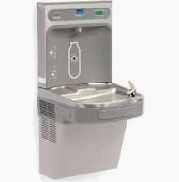
Do not pour any drinks with coffee grounds or other food items down the water fountain drains.
-If caught, you’ll be issued a detention

Slide 19
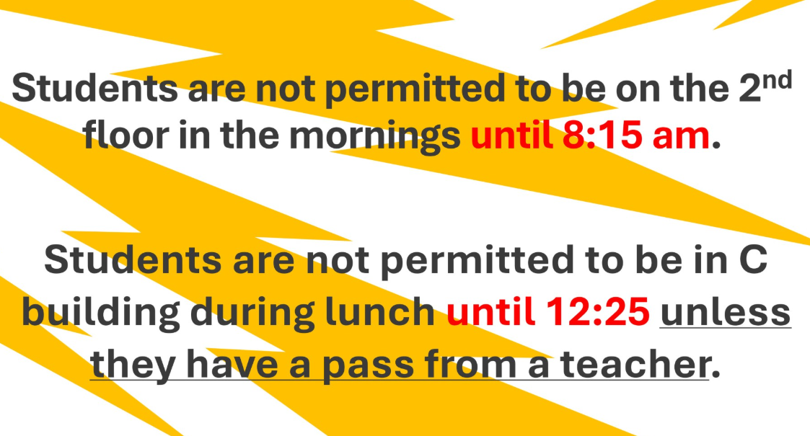

Slide 20





Attention Students
•Do Not Spray any Body Sprays , Perfumes or Cologne in the Classroom, Restroom or Locker rooms. Anyone caught will receive a Detention

Slide 21
Transportation Discipline Matrix
1st Offense Warning parent notification
2nd Offense Change Seat Detention Parent notification
3rd Offense Bus suspension w/ referral
4th Offense Bus Suspension 3 days
5th Offense Bus Suspension 5 days
6th Offense Bus Suspension 9 weeks
7th Offense Bus Suspension for rest of school year

Slide 22
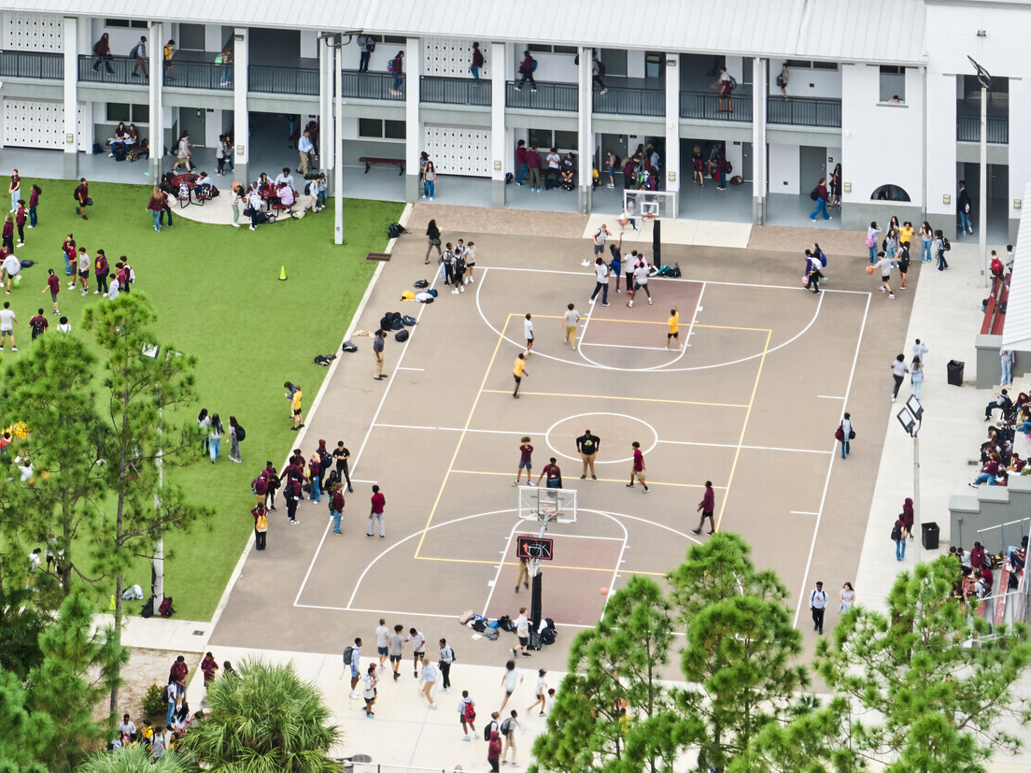
NO FOOD or drink ON THE COURT

Slide 23
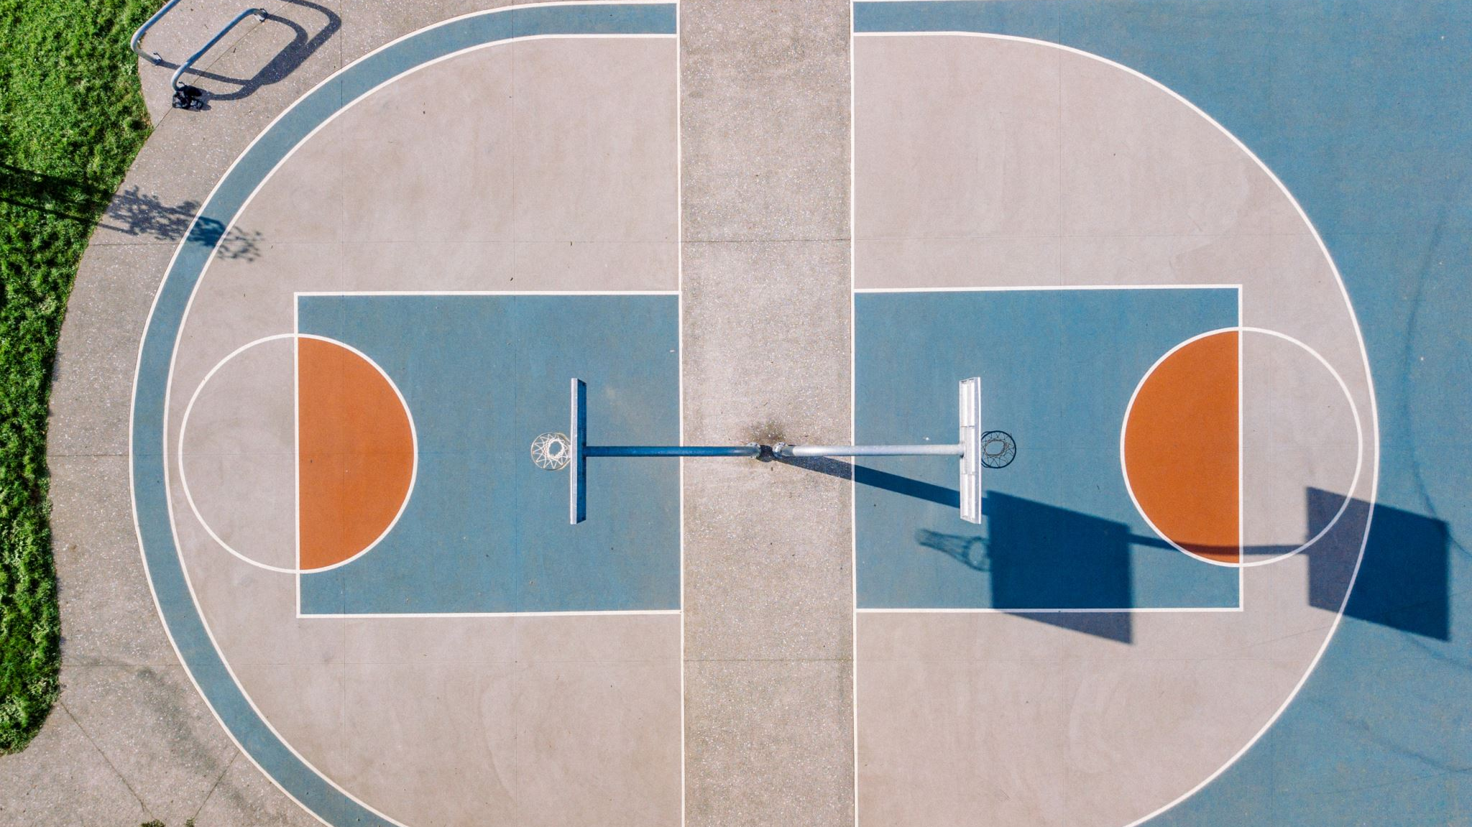
on basketball courts OR turf without a staff member present
(This means mornings & after school too.)
NO Playing ANY SPORTS

Slide 24
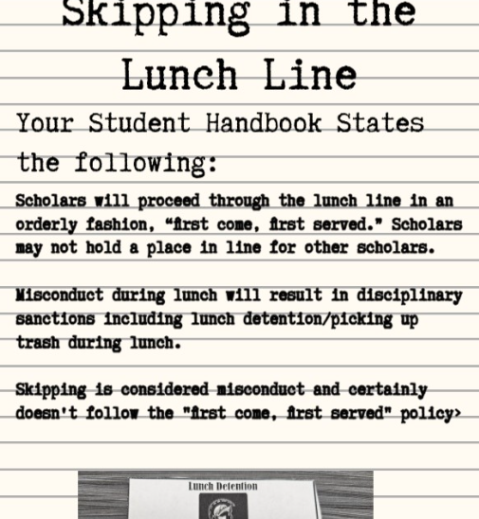


Slide 25
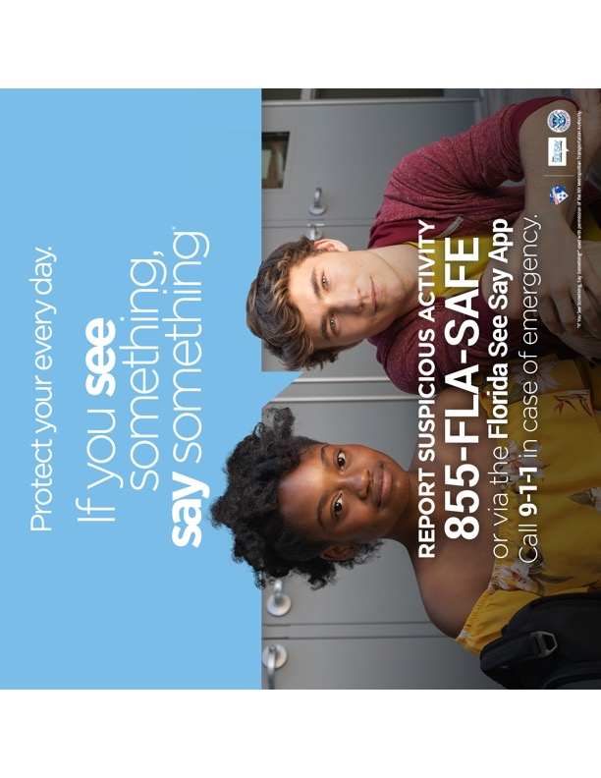
Tell an adult in our school!

Slide 26

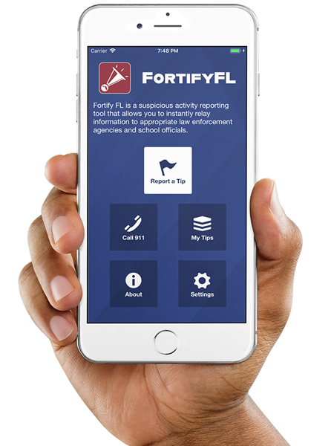
Anonymous Reporting App

Slide 27
ATTENTION STUDENTS!!
Did you know that the Florida Department of Law Enforcement and the Florida Department of Education created an anonymous reporting App that allows you to instantly send information about suspicious activity to local law enforcement and school officials?

Slide 28
WHY?
It is important to always remember that If You See Something, Say Something! With FortifyFL, you can easily submit information about potential crimes or threats which will immediately be forwarded to law enforcement and designated school personnel.

Slide 29
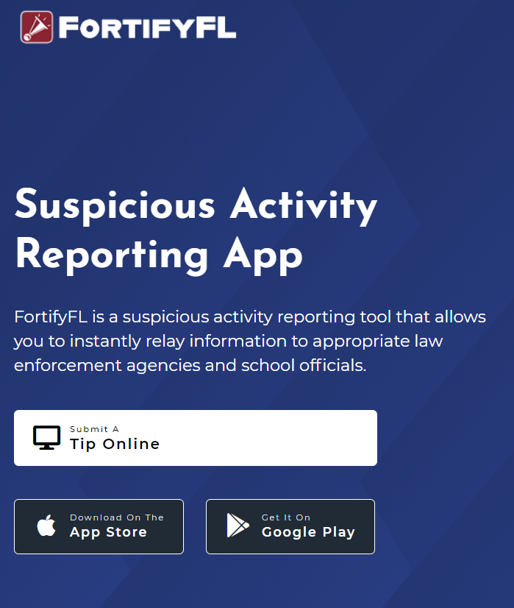
HOW DO I SUBMIT A TIP?
You can submit a tip from any computer at: https://getfortifyfl.com/

Slide 30
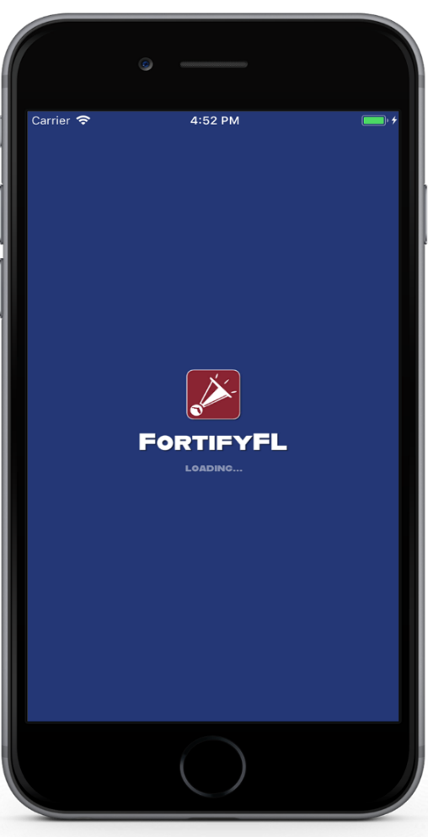

HOW DO I SUBMIT A TIP?
You can also submit a tip using your cell phone. Download the FortifyFL App on your mobile device.

Slide 31
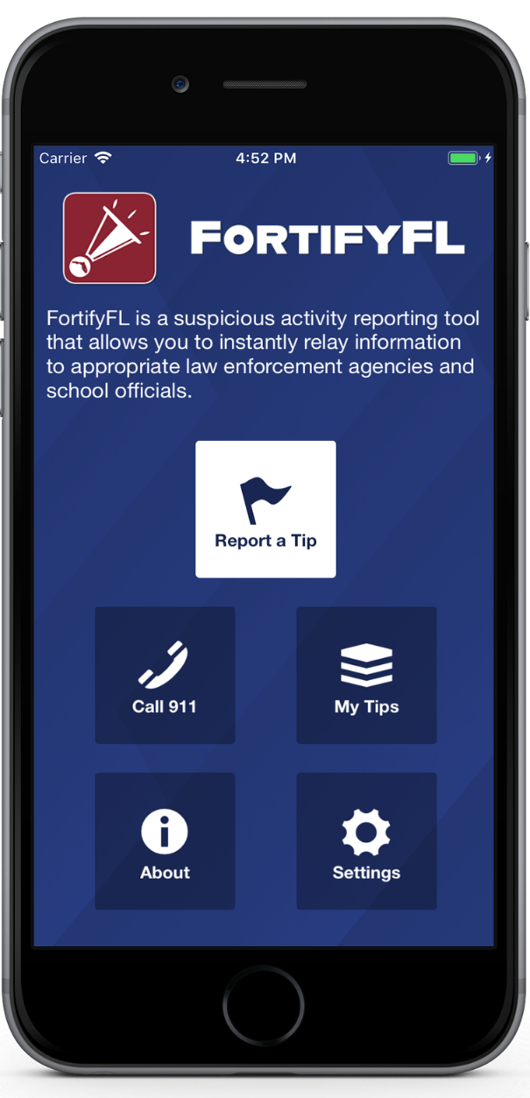
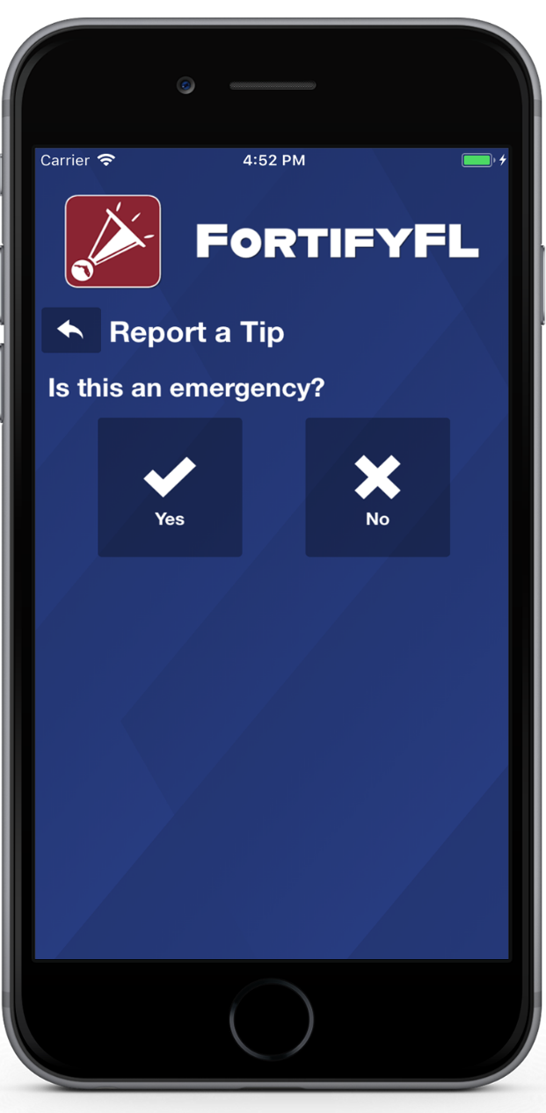
HOW DO I SUBMIT A TIP?
Click “Report a Tip,” and indicate if it is an emergency

Slide 32
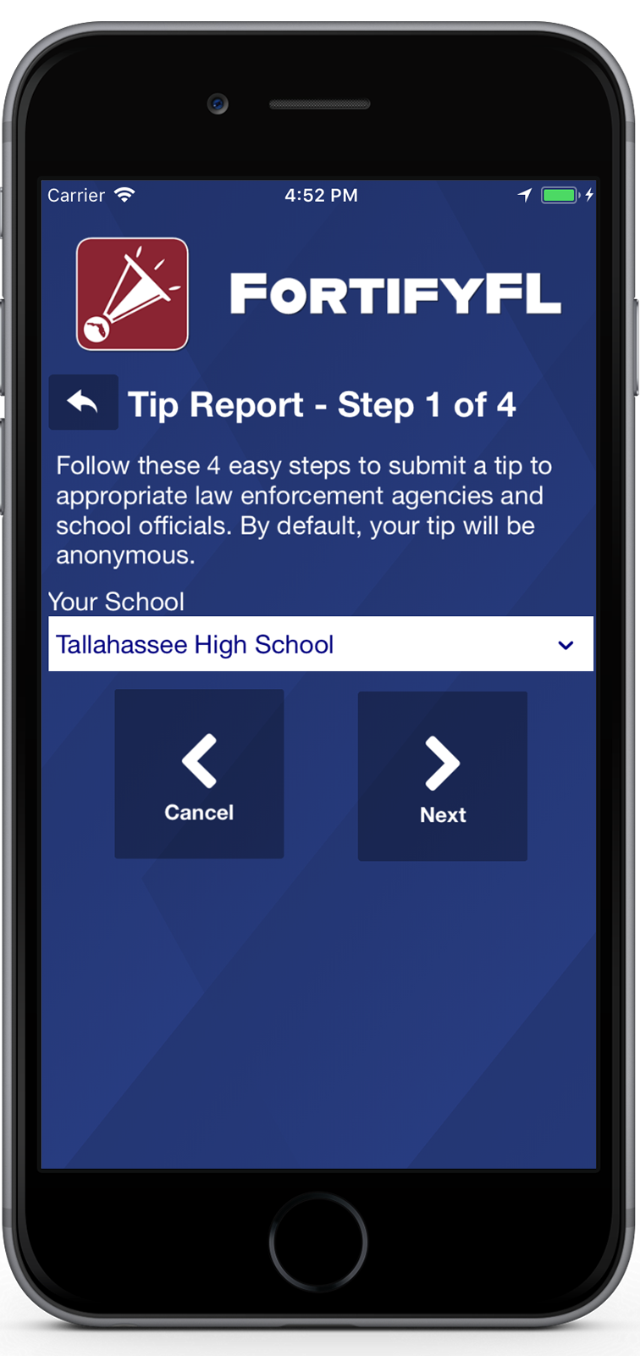
HOW DO I SUBMIT A TIP?
Step 1: Select Your School

Slide 33
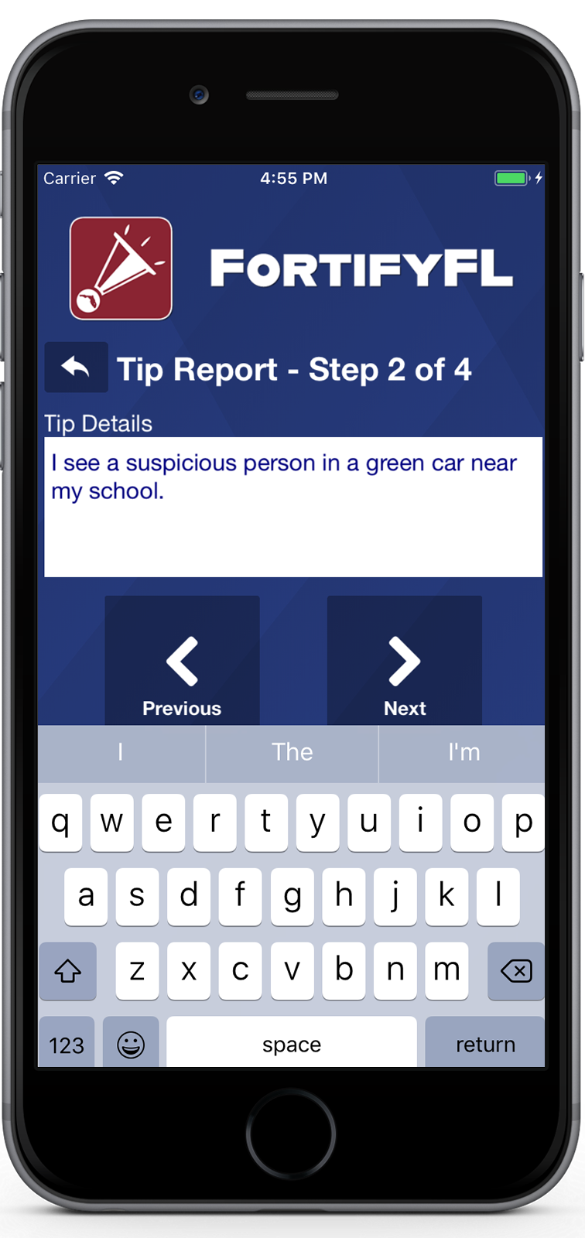
HOW DO I SUBMIT A TIP?
Step 2: Provide Your Tip

Slide 34
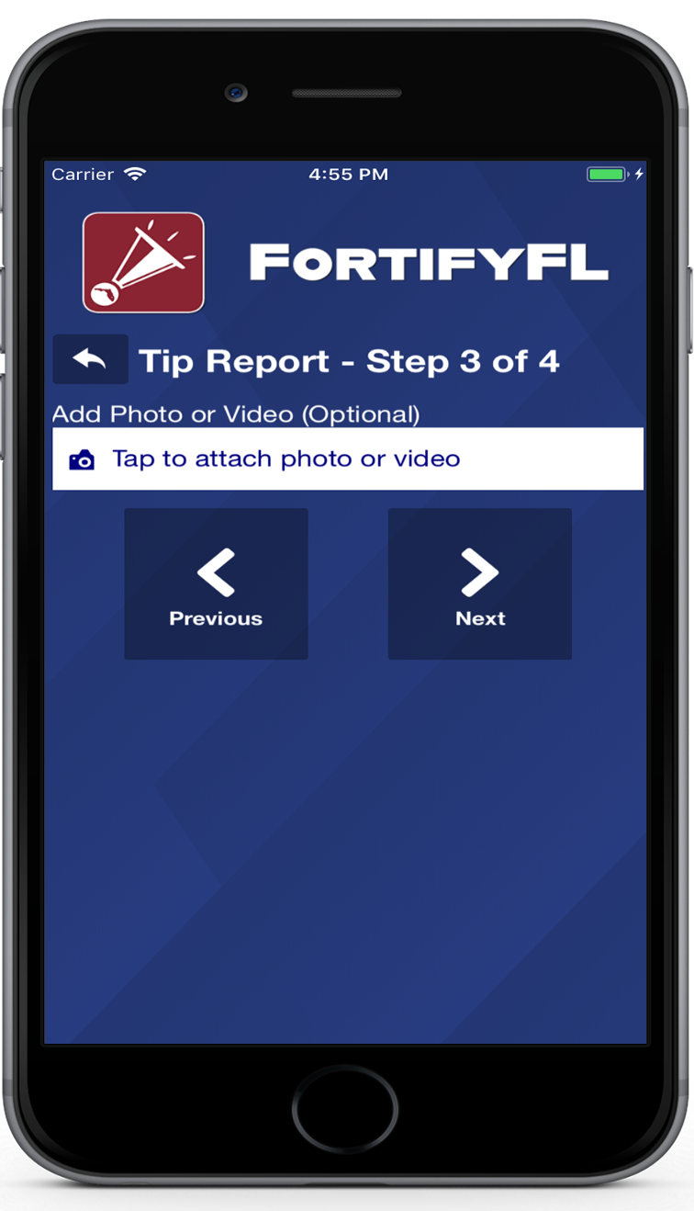
HOW DO I SUBMIT A TIP?
Step 3: Attach an Optional Photo or Video

Slide 35
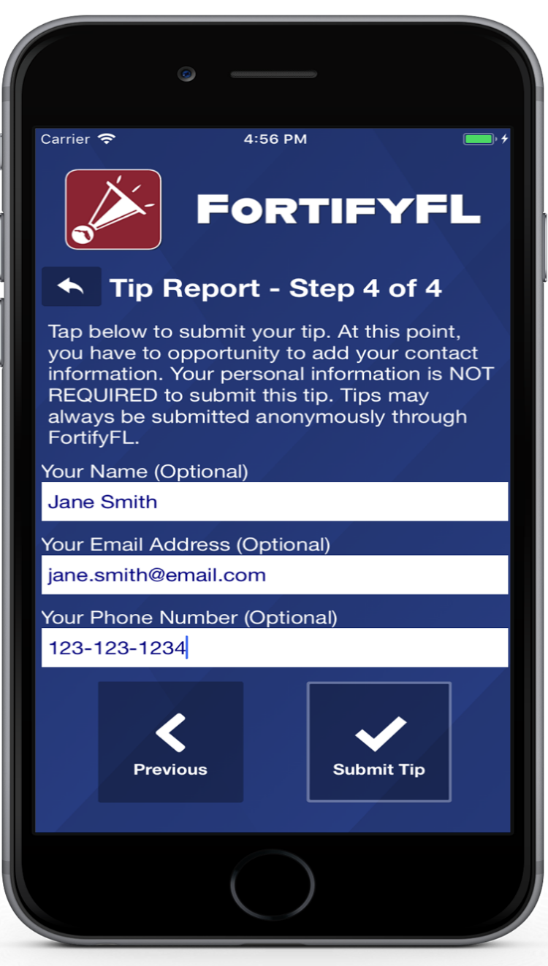
HOW DO I SUBMIT A TIP?
Step 4: Provide Optional Information and Submit Your Tip

Slide 36
False Tips Lead to possible Criminal penalties
If someone who knowingly submits a false tip through FortifyFL may be subject to further investigation by law enforcement, and may be subject to criminal penalties under Section 837.05, F.S.

Slide 37
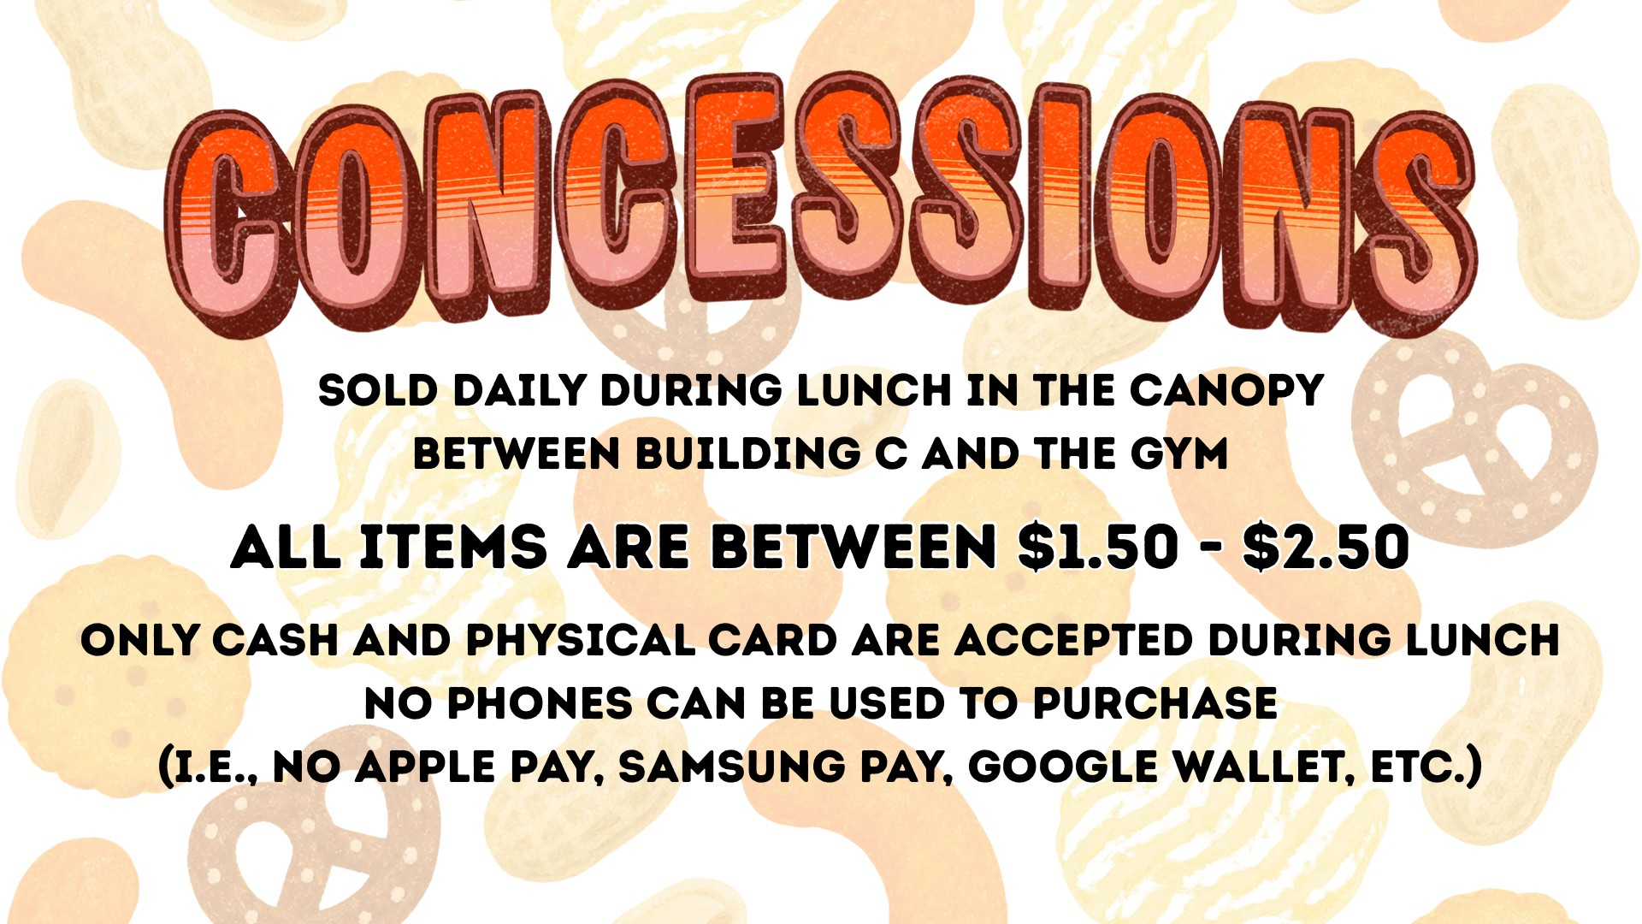

Slide 38
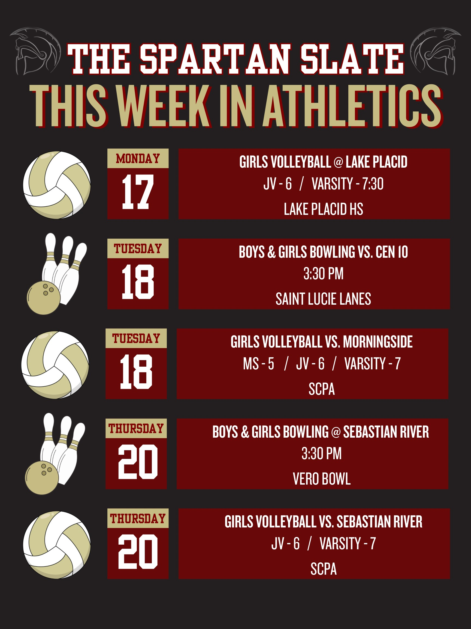

Slide 39
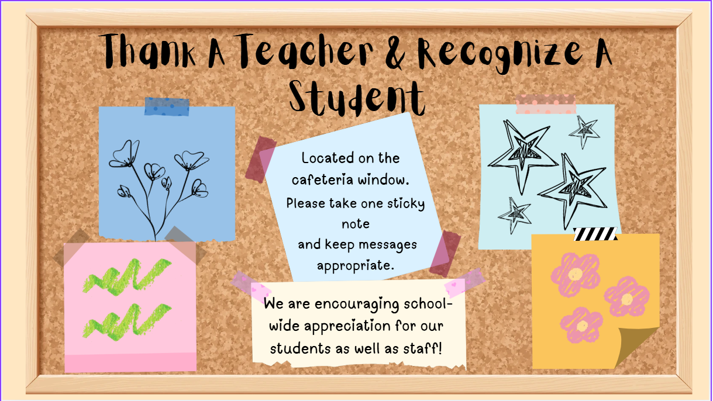

Slide 40


Slide 41


Slide 42


Slide 43


Slide 44


Slide 45


Slide 46
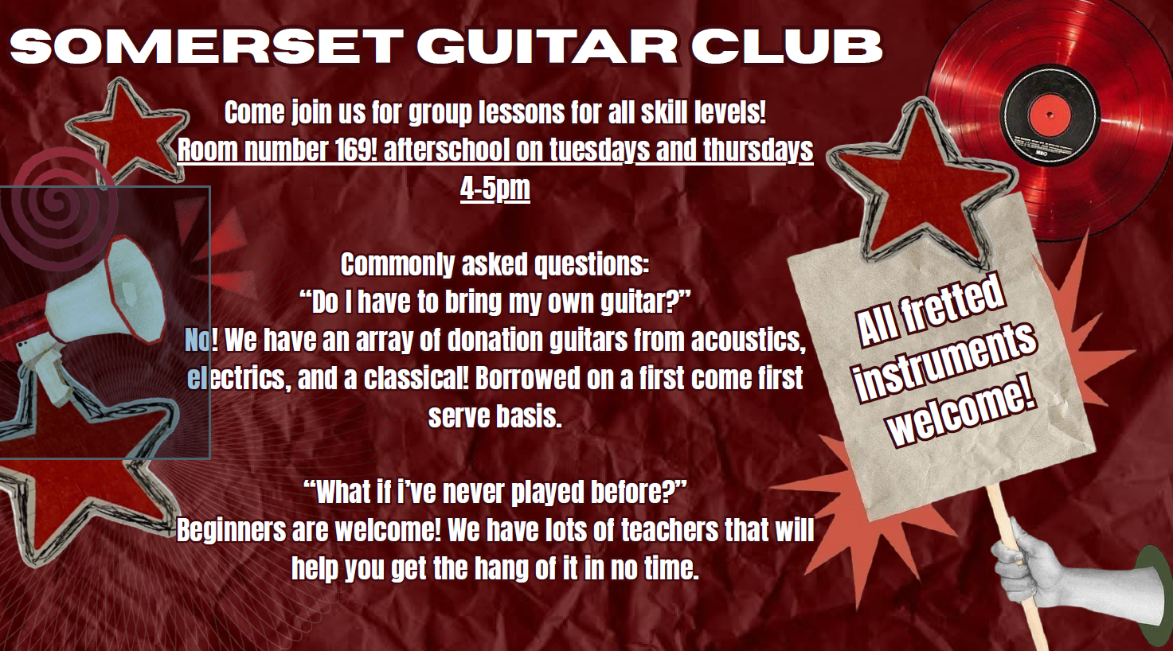


Slide 47


Slide 48


Slide 49


Slide 50


Slide 51


DRAMA CLUB FIRST MEETING!
New year, new members, new plays!
Every Tuesday @4pm to 5pm in room 167!
No experience required! Open to all grades!
Contact Mr. Nottage if you have any more questions!

Slide 52
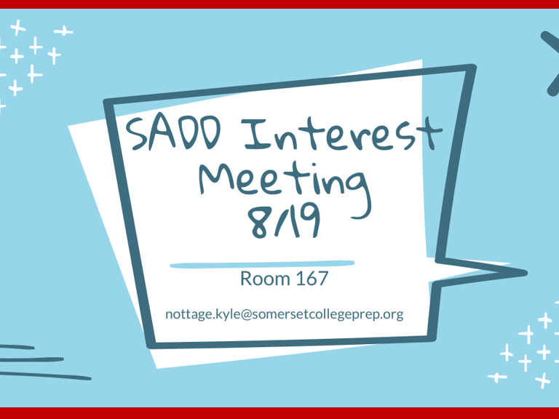

Slide 53


Open Sesame: Library Edition!
With Ms.Abel
Library is now open Only on Wednesdays during Lunch
Borrowing books: Sign the book out on the sign out sheet
Return in 2 weeks!
RM:232

Slide 54

🐝 SPELLING BEE 🐝
Who can participate?
📚 Middle School & High School Students
✏️ Written Portion
  Complete a spelling test with challenging words
  Show off your vocabulary and spelling skills
🎤 Oral Portion
  Finalists will compete by spelling words aloud
  Listen carefully, think confidently, and spell it out!
📝 WANT TO PARTICIPATE?​
Sign up on the sheet outside Ms. Abel’s door!​
-We want 2 Middle School and 2 High school Winners
-Each win a gift card and a trophy
-The middle schoolers will represent SCPA at the nationals
👉 Add your information so Ms. Abel can reach out to you with more details.​
Think you can spell it? Prove it! 🐝​

Slide 55
National Honor Society and National Junior Honor Society Interest Meeting!
National Honor Society Requirements:
Sophomore standing (10th-12th graders)
3.5 unweighted GPA
Zero referrals
75 community volunteer hours recorded by administration
National Junior Honor Society Requirements:
7th grade standing (7th-9th graders)
3.5 unweighted GPA
Zero referrals
We hope to see you in room 249-B on August 19th!

Slide 56




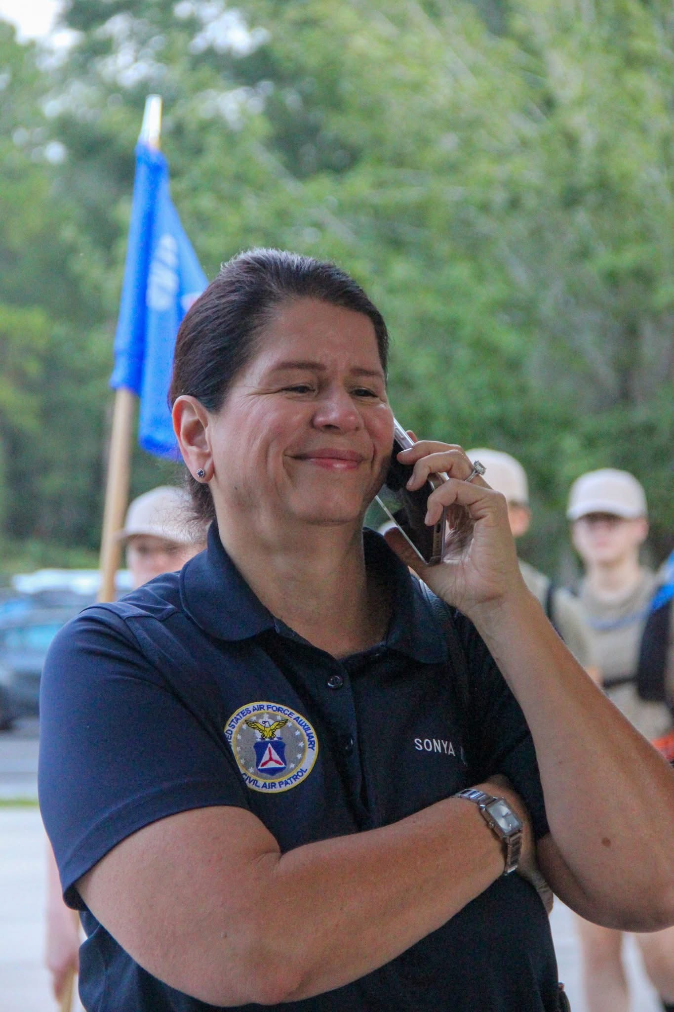

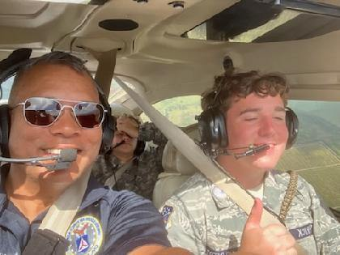
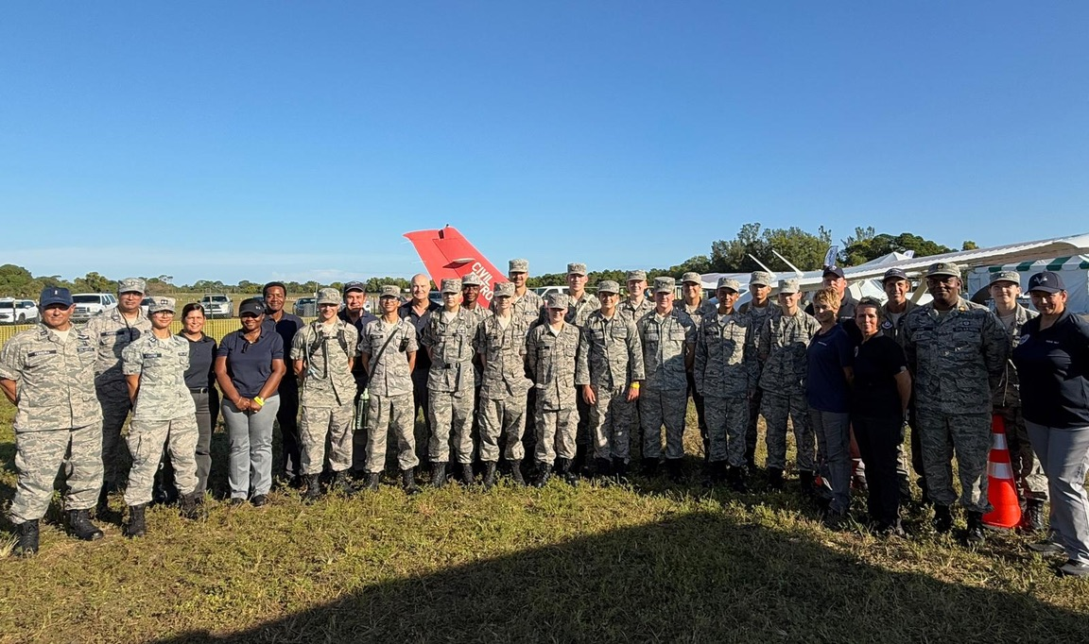
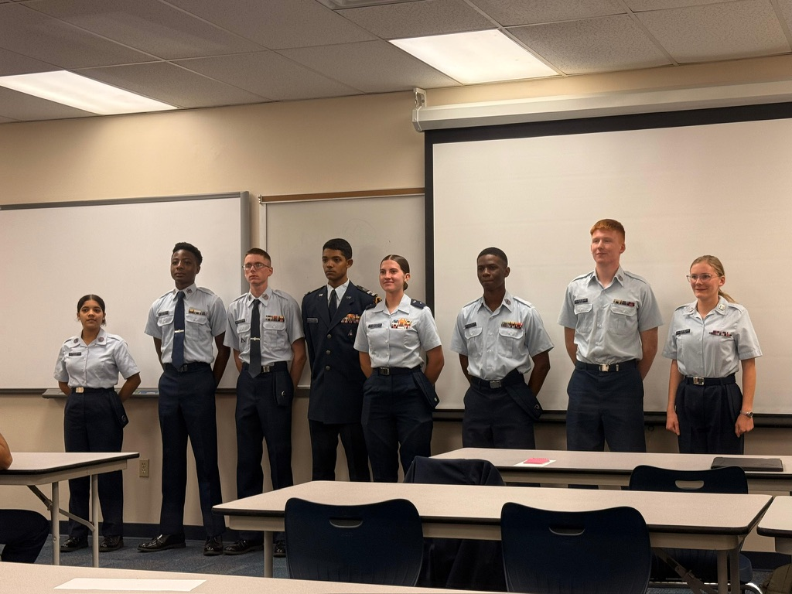
The Civil Air Patrol offers.
Free Orientation Flights
Help prepare you for the Air Force
Teamwork and Leadership skills
Stem-kit programs and education
Scholarship opportunities and more!
Are you interested in
Aerospace, Leadership, or Emergency Services?
Welcome to the...
Civil
Air
Patrol
Contact our Squadron commander today! At: Sonya.Milu@FlwgCap.us
Adults can join also!
Every Tuesday at 6:50 pm IRSC Chastain Campus Building B 2400 SE Salerno Rd.
Stuart FL. 34997

Slide 57
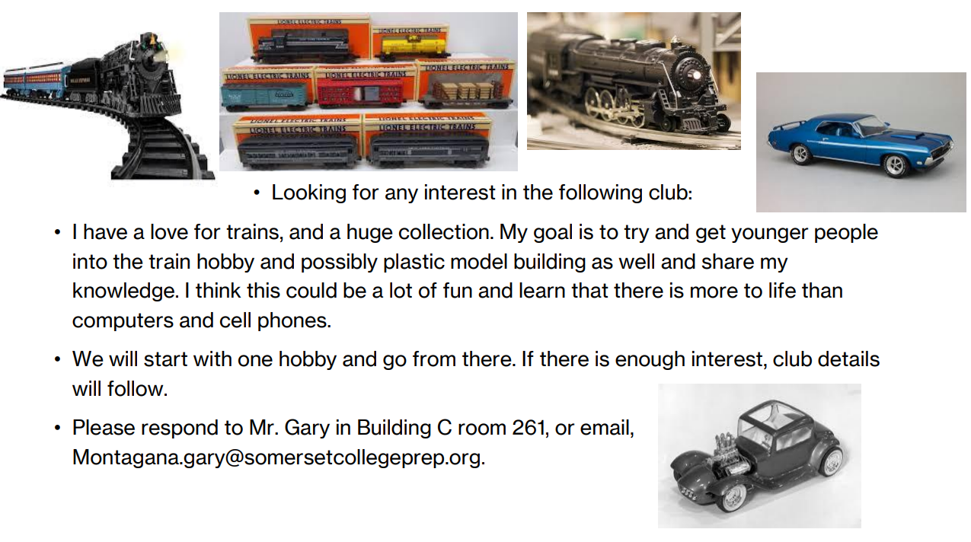

Slide 58



Slide 59

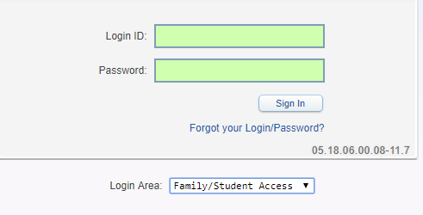
Student Skyward Access
Login ID: (Student 562#)
Password: (8 Digit Birthdate - MMDDYYYY)
Example: 08032005
**You May access Skyward through the school’s website.

Slide 60

Interested in starting a school club?
If you’re interested in starting a school club, you should do the following:
  Find a teacher to sponsor the club. Give them the details about the club so they know if they’re able to sponsor the club.
  Create a petition and get students who would be interested in your club to sign it. This shows that your club has generated interest.
  Talk to someone in administration about getting your club approved. Tell them who the sponsor is, when the club will occur (lunch or afterschool), and what the club entails.
  Email Mr. Kyryliw (Kyryliw.Michael@somersetcollegeprep.org) the information about you club and a slide advertising it. I will leave the advertising slide up for a week or so and create a slide listing all the club information for easy reference.

